Slide 1
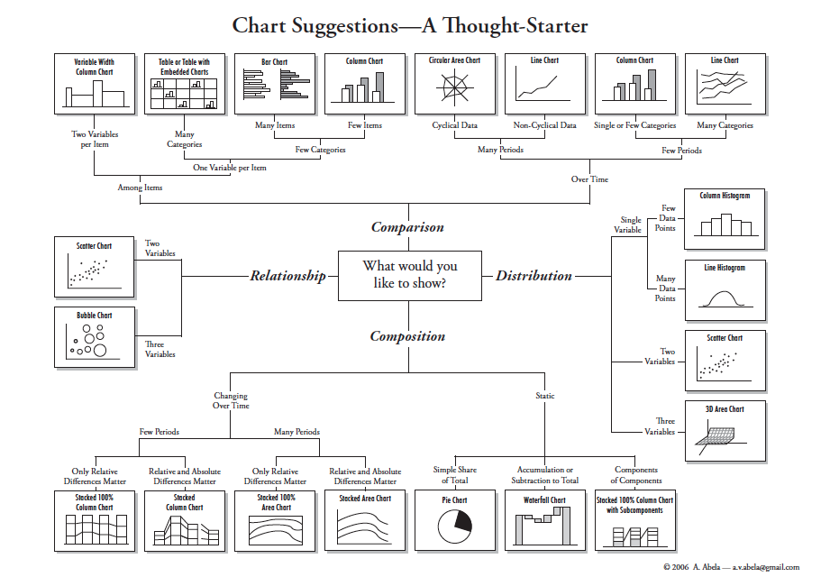
Source : Extreme Presentation

Slide 2
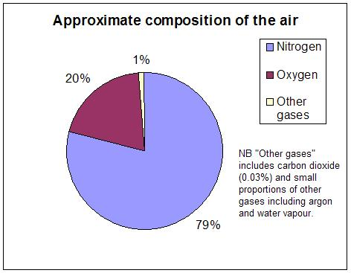
Composition : Pie
Pie Chart – Composition, Static
Image source: Wikimedia Commons

Slide 3
Composition: Pie
What? Pie chart of composition of air
Why? When something sums to 100% or when the main point you wish to communicate is what proportion of a static figure belongs to a category, a pie chart is a good idea. Notes: Avoid 3D effets, use contrasting colors, do not label very small slices ( club categories below 5-10% or use a different visualization)

Slide 4
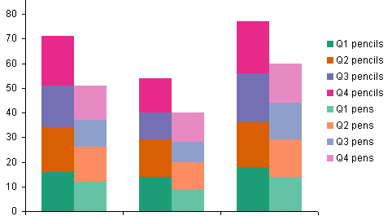
Composition : Bar
Bar Chart – Subcomponents, Static
Source: Stack Overflow

Slide 5
Composition : Bar
What? Comparison of pencil and pen sales in 4 different quarters for 3 companies
Why? When you need to communicate stratified data over different categories, this is a good choice.
Notes: Keep logically attached entities together ( pens+pencil sales of single company together vs 4 different quarter bars and pen and pencil breakups), avoid 3-D effects, ensure boundaries between subcomponents are clear

Slide 6
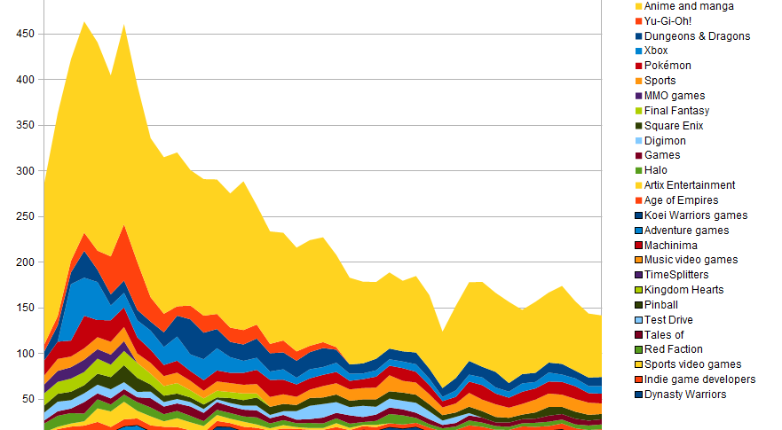
Stacked Area Chart – comparison over time
Source: Wikimedia Commons

Slide 7
Time series – Stacked area chart
What? Anime consumption by hits over time for different shows
Why? Lots of data over time for many categories
Notes: Keep contrasting colors for categories close by, try to adjust scales to show changes in trends clearly and faithfully, very useful for time series data

Slide 8
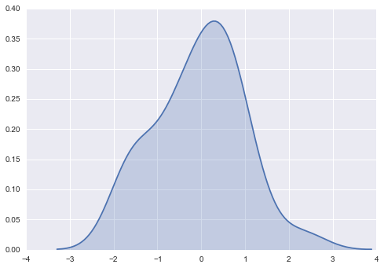
Histogram
Source: Seaborn

Slide 9
Note: A histogram is your best friend when performing exploratory data analysis or confirming statistical inferences!
While building models , use it to
- get an intuition about your data
See the performance of your models
Test assumptions about the distribution of errors etc to confirm assumptions

Slide 10
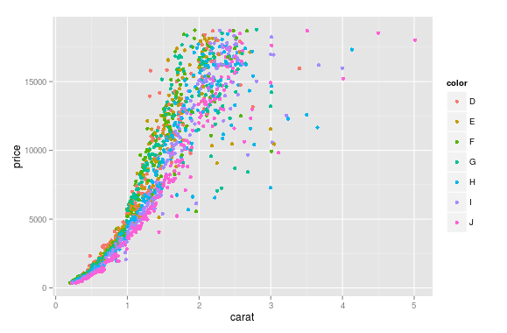
Relation/ Distribution : Scatter Plot
Source: Stack Overflow

Slide 11
Relation/ Distribution : Scatter Plot
What? A plot of price vs size of diamonds for different categories.
Why? Given raw data, it’s a good idea to plot a scatter plot to see if there is any relation at all between attributes of the data. Notes: Its also a good idea to code different categories as colors. When trying to see the relation with a continuous variable, using a color gradient also works well.

Slide 12
Chart Design Principles Edward Tufte
Avoid chart-junk – unnecessary visual elements like background photos, 3-D effects, anything that does not add more information to the graph
Maximize data-ink ratio: Encode more information on the graph using both visual elements and ,where needed, labels

Slide 13
Chart Design Principles from Edward Tufte (contd. …)
3. Chart integrity – size of effect on graph proportional to size of effect in data
4. Clear titles, legends, labels and appropriate scales

Slide 14
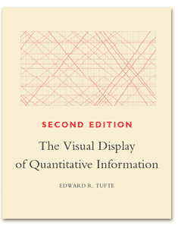

Further Reading
Tufte in 20 Minutes – Pamela Brown and Russ Acker, UC Berkley
Extreme Presentation, a helpful blog
Books

